Slide 1
Agile Principles and Practices
Agile Development Processes
Eric Knauss

Slide 2
Announcements
Some students have joined late. Please register for group work:
https://www.surveymonkey.com/r/EDA_397_2017
Any Roadblocks?

Slide 3
Overview (might take 2 lectures)
Principles
Artefacts and Tools
Practices
XP
Scrum
Kanban (you did watch the video, right?)
Later: Lean software development

Slide 4
Course Objectives
Knowledge and understanding | Skills and ability | Judgement and approach
Compare agile and traditional softw. dev, | Forming a team organically | Explain: people/commun. centric dev.
Relate lean and agile development | Collaborate in small software dev. teams | Apply fact: people drive project success
Contrast different agile methodologies | Interact and show progress continuously | Describe: No single methodology fits all
Use the agile manifest and its accompanying principles | Develop SW using small and frequent iterations | Discuss: methodology needs to adopt to culture
Discuss what is different when leading an agile team | Use test-driven dev. and automated tests
 | Refactor a program/design
 | Be member of agile team
 | Incremental planning using user stories
Sprint 3
Sprint 1
Sprint 2

Slide 5
User story
Widely accepted template: As a <role> I want to <feature> so that <customer value>
Promise to discuss this user goal further
Keep track of what the team is doing
A lot of value in physical artifact
Usually good idea to add: ID, Story Points, List of sub-tasks, Indication of customer value, notes on the backside

Slide 6
Agile Principles – Revised list (according to [Mey2014])
Organizational
Put the customer at the center.
Let the team self-organize.
Work at a sustainable pace.
Develop minimal software:
Produce minimal functionality.
Produce only the product requested.
Develop only code and tests.
Accept Change
Technical
Develop iteratively:
Produce frequent working iterations.
Freeze requirements during iterations.
Treat tests as a key resource:
Do not start any new development until all tests pass.
Test first.
Express requirements through scenarios.
6. Reflect regularly and improve continuously!
Notes:
Discuss with your neighbour: Name 2 that are easy and 2 that are difficult to adhere to in your project.

Slide 7
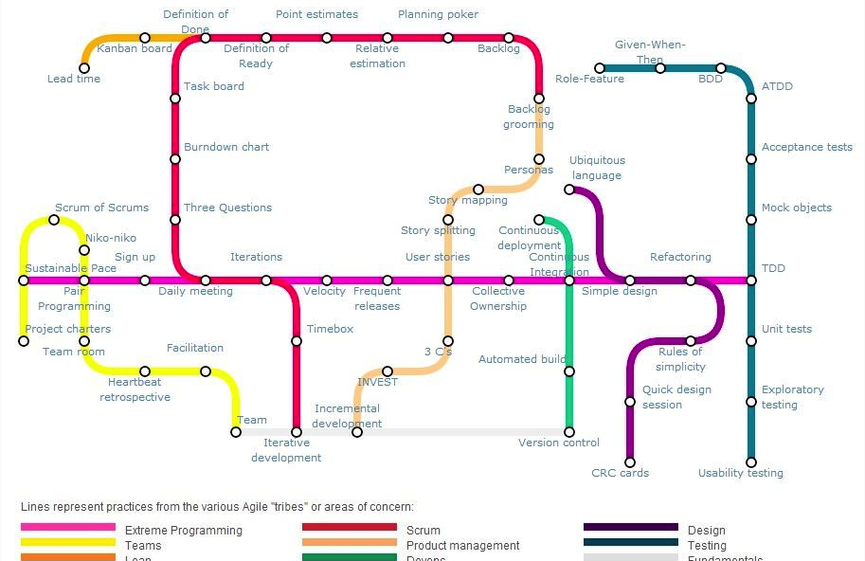
Agile Practices
https://techblog.betclicgroup.com/wp-content/uploads/2013/12/agileSubwayMap2.jpg
Also check: http://guide.agilealliance.org

Slide 8
XP Principles
Core
Less central
Rapid feedback
Assume simplicity
Incremental change
Embracing change
Quality work
Teach learning
Small initial investment
Play to win
Concrete requirements
Open, honest communication
Work with people’s instincts, not against them
Accepted responsibility
Local adaptation
Travel light
Hones measurement

Slide 9
XP Practices
Planning game
Small releases
Metaphor
Simple design
Testing (dedicated lecture)
Refactoring
Pair programming
Collective ownership
Continuous integration (dedicated lecture)
40h week
On-site customer
Coding standards

Slide 10
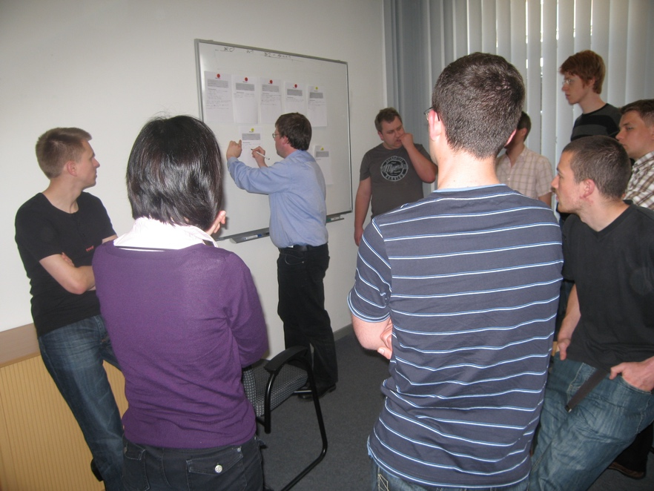
Planning Game
Basic idea
Create a rough iteration plan
Plan next iteration in detail
Players
Onsite Customer
Team
(Coach)
Moves
Write User stories (OC + Team)
[do some filtering]
OC ranks US by business value [assign Fibonacci numbers]
Team assigns story points [Planning poker]
OC put story cards in strictly prioritized order
Team selects the top n stories to match their velocity

Slide 11
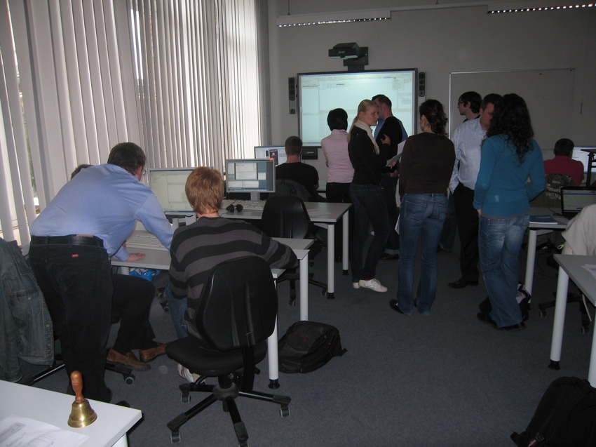
Pair Programming
Basic idea
Two people on one computer
Take one user story with them
Review each other
Share knowledge
Related concepts
User story as vertical increment
Truck factor
Sentiment in research
Studies with contradictory results, clearly leaning towards rejecting the idea of using pair programming in general
But Long term aspects of knowledge management not/insufficiently covered
Good results for specific use cases (exploration, difficult task, knowledge sharing, …)

Slide 12
Scrum Principles
Reflection
Stop and review product & process
Self-correction
Based on reflection
Visibility
Everything is visible (=known) for all stakeholders, e.g. plans, schedules, issues, …

Slide 13
Scrum practices
Product backlog vs. Sprint backlog
Sprint planning
Planning poker: estimate cost
ROI (Return on Investment): cost vs. benefit
Retrospective
Fixed sprint length
Burn-down charts
Daily scrum: no longer than 15min

Slide 14
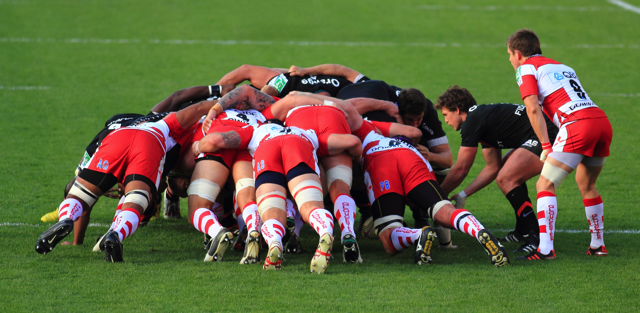
Overview: XP and Scrum
https://en.wikipedia.org/wiki/Scrum_(rugby)

Slide 15
SCRUM Practices Hints
SCRUM Meetings
SCRUM Master minds the time (2-3 min./Person)
Standup-meeting: faster
Replace status meetings – safe time
Important: Always same time and place!
(not important: where)
Daily / frequent meetings avoid long/quiet crisis
Content
What was done since the last meeting?
What is planned to be done before the next meeting?
Found obstacles? Write on whiteboard!
Useful: Share information and facilitate social aspects
Schedule further meetings to follow up on things (e.g. obstacles)

Slide 16
SCRUM Practices Hints
Sprint
During sprint: Autonomous team: Pioneers
No new requirements / no changes
No external influences
Only sprint goal
Fixed: Time (approx. 30 Tage), Cost (Developers etc.), Quality
Variable: Functionality
Team can adjust details and scope of functionality based on the time-cost-quality frame and with respect to the sprint goal
Sprint can be cancelled
After Sprint: 4h Sprint-Meeting
Avoid long preparation (max. 2h)
Avoid slides
Often very informal
Adjust SCRUM (longer Sprints, other Meetings…)
Okay, after being successful with the traditional setup
Only based on experiences – never without experience
Notes:
Während die Aussenwelt nicht in den SCRUM eindringen darf, darf das SCRUM-Team durchaus mit der Außenwelt in Kontakt treten. Zum Beispiel, wenn das Sprint-Backlog doch zu viel Arbeit ist – oder zu wenig.

Slide 17
Scrum
Others
SCRUM Master
Product Owner
SCRUM team 7+/-2
SCRUM
Room
Increment
Product
Backlog
(prioritized)
SPRINT
Backlog
Daily SCRUM 15 min.
SPRINT: 30 days
Notes:
Hier sieht man auf einem Bild alle wesentlichen Elemente von SCRUM.
Der Product Owner (ein Kunde) hütet den Product Backlog. Er darf ihn jederzeit verändern, insbesondere die Reihenfolge von Einträgen verändern.
Wenn ein Sprint beginnt, wird soviel oben vom Product Backlog genommen, dass es für den Sprint langt. Dann schließt sich die Kapsel, in den nächsten 30 Tagen darf niemand dem SCRUM-Team hineinreden oder den Sprint-Backlog ändern.
Intern werden jeden Tag SCRUM-Meetings statt finden, am Ende des Sprints wird Software erzeugt.
Der SCRUM-Master erinnert an den Projektleiter, ist es aber nicht. Denn ein SCRUM-Team ist selbstorganisierend. Die Hauptaufgabe des SCRUM-Masters ist es, Schwierigkeiten auszuräumen, die im Daily SCRUM geäußert werden.
Andere dürfen zusehen, im Dails SCRUM aber nichts sagen.

Slide 18
Scrum: organization
Project-goals: Project Backlog
Coord. of
multiple
Teams
Multiple SCRUM-Teams sprint in parallel. Master-SCRUMs
SPRINT
With Backlog andGoal
Project of
SPRINTS
SPRINT creates a Product-Increment
SPRINT
Review 3h
Planning
SPRINT im
30 SCRUM-Takt
Dailiy SCRUM Post-
Build (15 min.) discuss.
A workday:
SCRUM to SCRUM
Workday
Or alternatively:
Notes:
Dies ist die „Seitenansich“, in der man die Zeiteinteilung sieht.
Die untere Ebene ist jeweils ein Zoom in die obere.
Der Arbeitstag kann unterschiedlich gegliedert sein, solange nur jeden Tag ein Daily SCRUM und ein Daily Build stattfinden. Die sollen dann immer zur gleichen Tageszeit durchgeführt werden.

Slide 19
SCRUM vs. XP
XP is often hard to introduce
SCRUM is easy to introduce (according to Schwaber)
Best-practice: Combine!
SCRUM organizational shell: Day-to-day management
XP method of implementation
Shared values with XP
Quickly generate executable code
Facilitate communication
Notes:
„Crossbreed“: www.xbreed.net

Slide 20
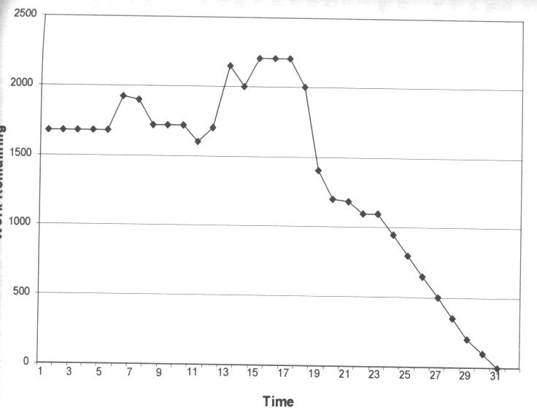
Assess Sprint Progress A possible trajectory
Frustration; Reduce scope wiht SCRUM-Master
Forgot to update after weekend: no change
More and more tasks appear
Good progress
c.f. Schwaber, Ken; Beedle, Mike (2002):
Agile Software Development with Scrum. Prentice Hall.
Notes:
An den Kurven kann man einiges ablesen. Sie werden täglich erstellt und zeigen, wie sich die geschätze Restarbeit entwickelt.
Es gibt einige typische Muster, die man häufig sieht.

Slide 21
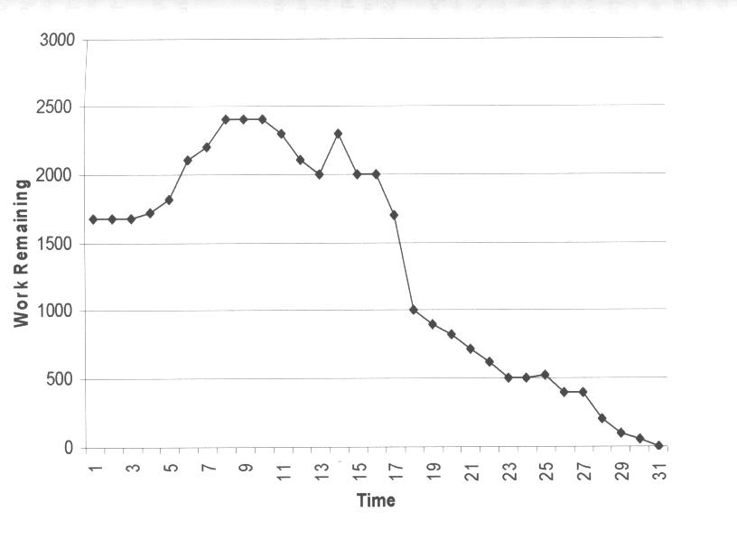
Assess Sprint Progress a typical trajectory for a new SCRUM-Team
Joint effort after week-end results in some progress
Frustration; Reduce scope wiht SCRUM-Master
Slow task, more and more effort appears
C.f. Schwaber, Ken; Beedle, Mike (2002):
Agile Software Development with Scrum. Prentice Hall.
Notes:
Hier zum Beispiel wieder die Bitte an den SCRUM-Master, mit dem Kunden auszuhandeln, dass die Aufgabe verkleinert wird.
Dadurch sinkt dann die Restarbeit auf einen Schlag.
Am Anfang steigt der geschätze Restaufwand, weil man durch die beginnenden Arbeiten erst mitbekommt, was noch alles fehlt und was davon wieder abhängt. Man entdeckt also immer mehr Konsequenzen und immer mehr Arbeit.

Slide 22
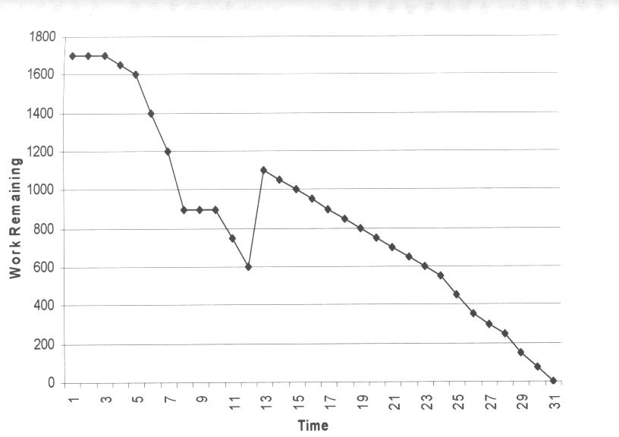
Assess Sprint Progress another typical trajectory
After slow start the team speeds up
Increase scope with Prod. Owner/ Scrum Master
On this foundation: Good progress
This way, the sprint goal would be reached too early
C.f. Schwaber, Ken; Beedle, Mike (2002):
Agile Software Development with Scrum. Prentice Hall.
Notes:
Das ist der andere Fall, in dem das Team in der Mitte noch mehr Arbeit nachholt, weil es sonst viel zu früh fertig würde.

Slide 23
Why does SCRUM work?
Integrated instability
Not too smoothly
Self-organizing teams
Take ownership
Multi-Learning
Between functions
Between group, organization, and individual
Subtle controll
Constant learning
Experienced developers in new teams
Risk management
Risk: Customer unhappy
Show working system often
Risk: Incomplete feature set
Prioritize: If something is missing, it is not important
Risk: Bad estimation
Daily updates during SCRUM
Risk: Lack of experience with Development cycle
Test early and execute repeatedly
Risk: Changes in performance estimation
No impact on Sprint
c.f. Schwaber, Ken; Beedle, Mike (2002):
Agile Software Development with Scrum. Prentice Hall.
Notes:
SCRUM funktioniert also auch, weil es mit den genannten Risiken sinnvoll umgeht.

Slide 24
Summary SCRUM
SCRUM is a management shell
Around XP
Or other approach: Even waterfall possible
Overlap with XP, but differences exist
Similar values
Different practices
Partly complement each other
Not as much impact as XP, easier to introduce
Strength
Information flows not only in one direction
Multiple feedback cycles stabilize system

Slide 25
Kanban principles
Start with what you do now
Agree to pursue incremental, evolutionary change
Respect the current process, roles, responsibilities and titles
Leadership at all levels
The following is based on [KS2009]

Slide 26
Kanban core practices
Visualize
Visualization of workflow allows to understand and improve it
Limit Work-in-Progress
Limit the amount of workitems for each step
Introduce a pull-system
Manage flow
Measure how workitems flow through the process and understand, if a change improves the situation
Make policies explicit
Implement feedback loops
Understand (as a team) how good the process is working
Improve collaboratively, evolve experimentally
Whole team needs to share a theory on why (small) change helps

Slide 27
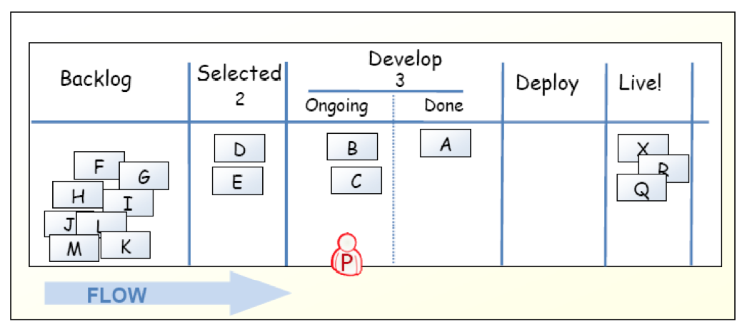
Kanban-Board
[KS2009]

Slide 28
Limit work in progress
We stopped here, 2017-03-31
Prevent context switching
Reduce multi-tasking
performing tasks sequentially yields results sooner
Maximize throughput
Enhance teamwork
working together to make things done
increase cross-functionality

Slide 29
WIP Strategy
Start with some initial value
Small constant (1-3)
number of developers
number of testers
Measure the cycle time
average time of one piece full cycle flow
Change limit to decrease cycle time

Slide 30
Idle Members
Can you help progress an existing kanban? – Work on that.
Don’t have the right skills? – Find the bottleneck and work to release it.
Don’t have the right skills? – Pull in work from the queue.
Can’t start anything in the queue? – Check if there is any lower priority to start investigating.
There is nothing lower priority? – Find other interesting work (refactoring, tool automation, innovation).

Slide 31
Metrics
Stories in progress (SIP)
When story enters stories queue set entry date (ED)
When story enters first process step set start processing date (SPD)
When story is done set finish date (FD)
Cycle time (CT) = FD – SPD
Waiting time (WT) = SPD – ED
Throughput (T) = SIP / CT

Slide 32
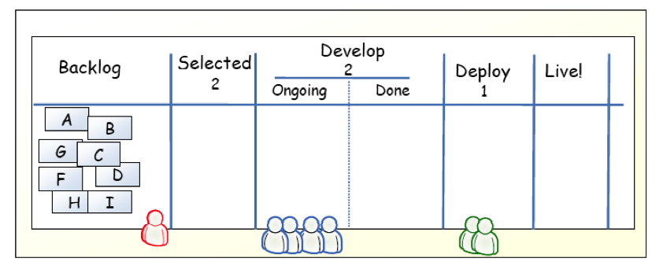
Example
[KS2009]

Slide 33
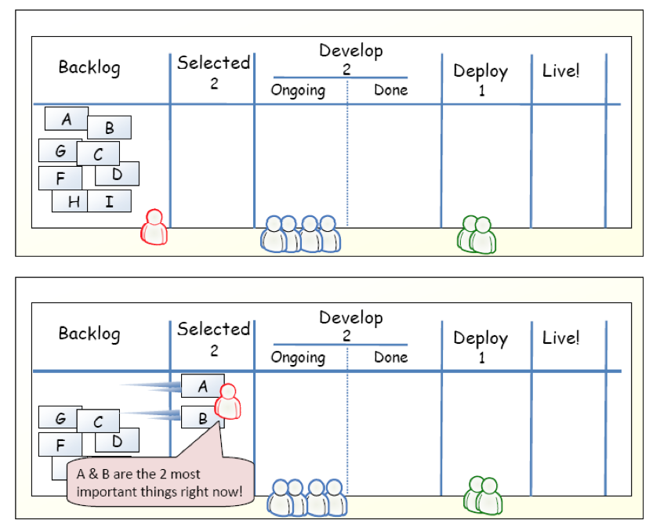
Example
[KS2009]

Slide 34
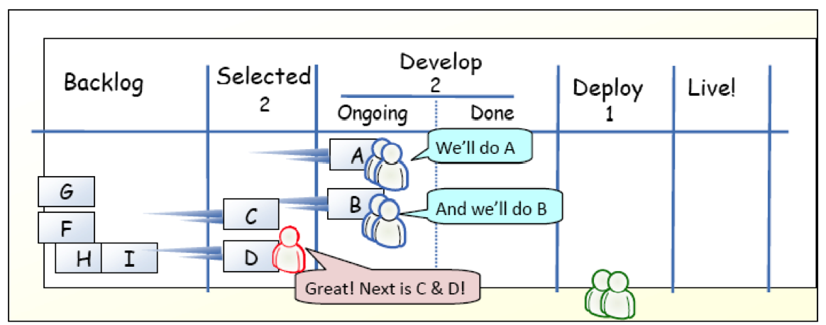
Example
[KS2009]

Slide 35
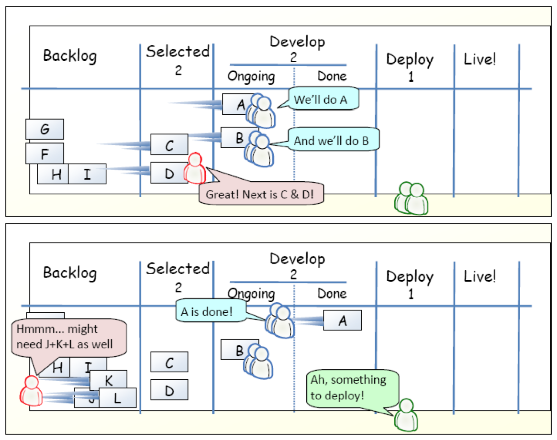
Example
[KS2009]

Slide 36
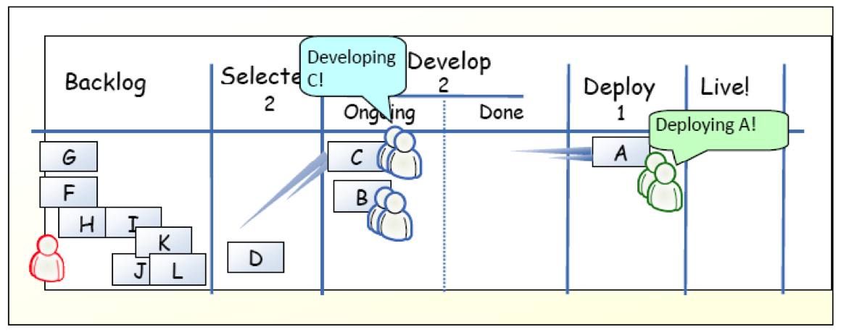
Example
[KS2009]

Slide 37
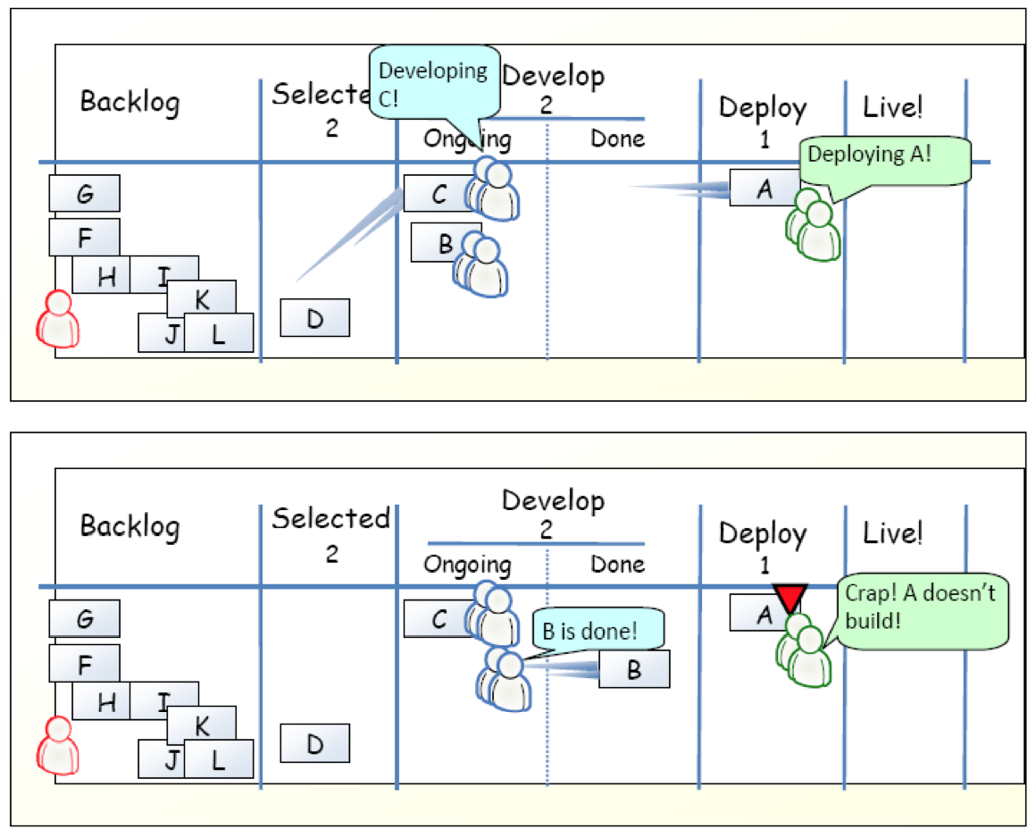
Example
[KS2009]

Slide 38
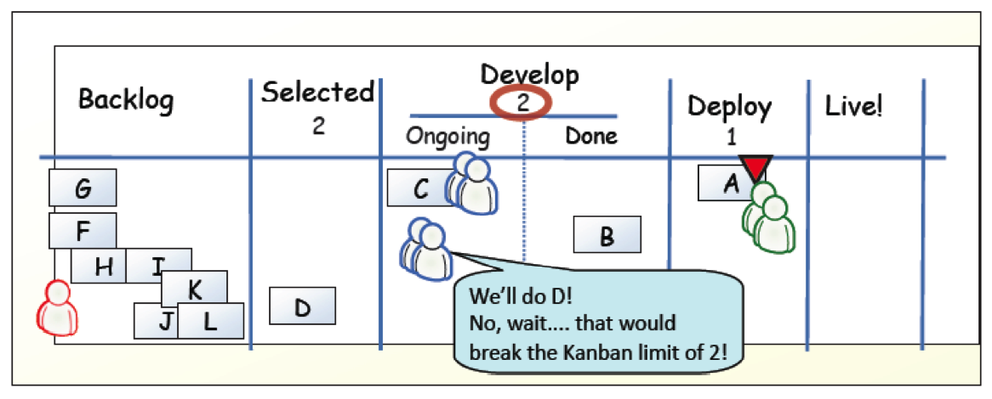
Example
[KS2009]

Slide 39
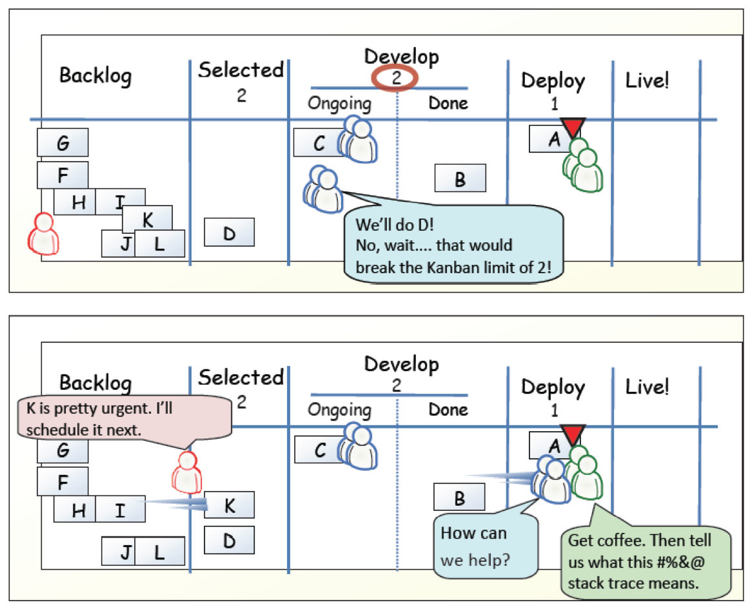
Example
[KS2009]

Slide 40
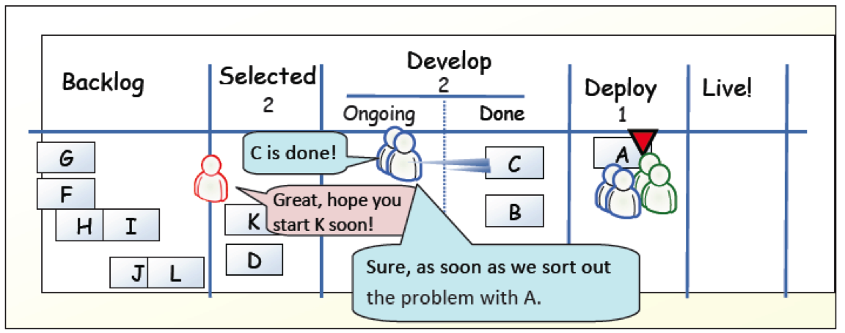
Example
[KS2009]

Slide 41
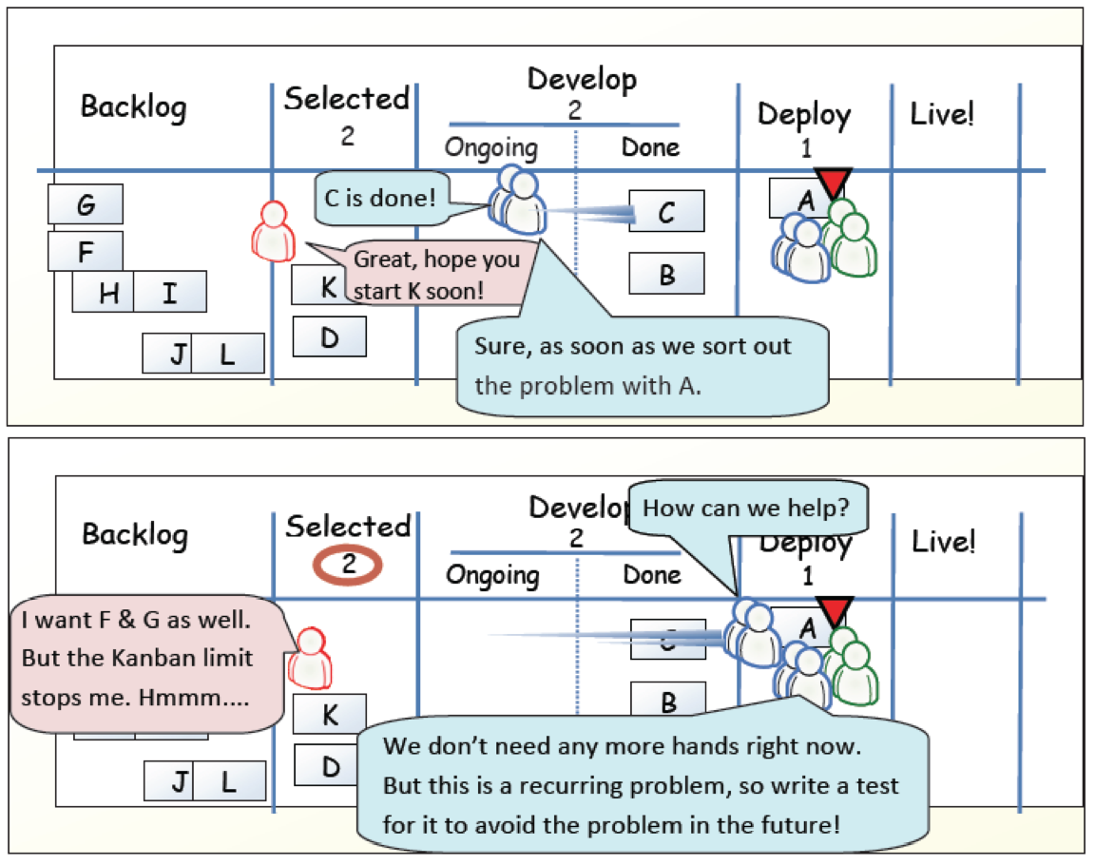
Example
[KS2009]

Slide 42
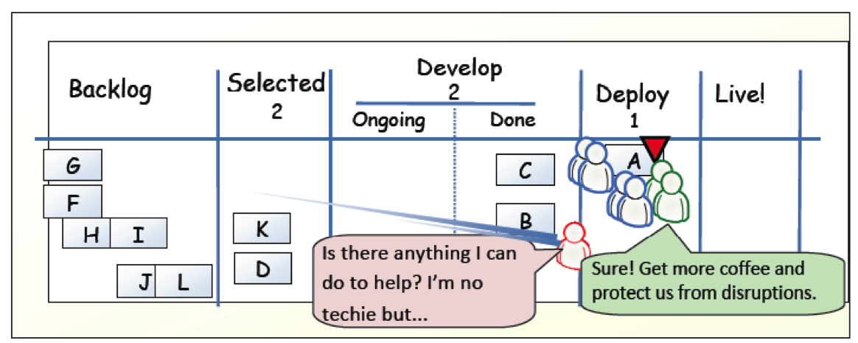
Example
[KS2009]

Slide 43
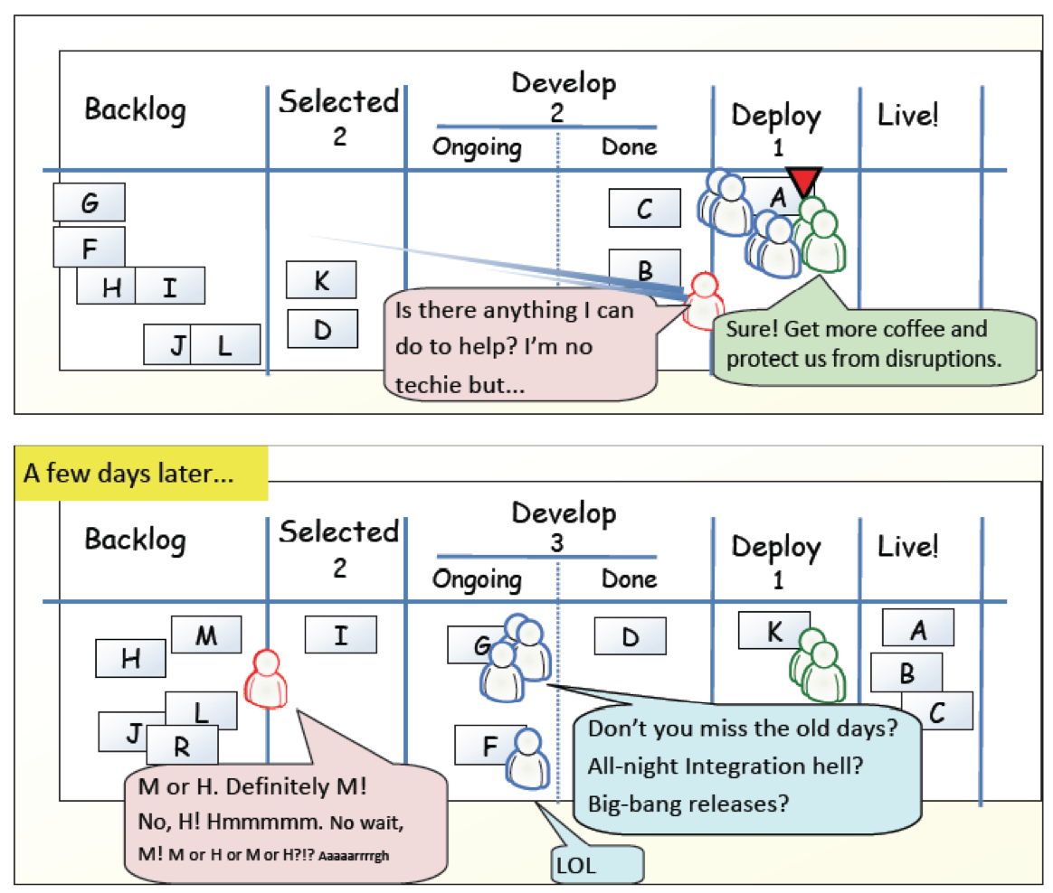
Example
[KS2009]

Slide 44
?
Compare Kanban with your favorite agile method.
What is similar?
What is different?
Is Kanban agile?

Slide 45
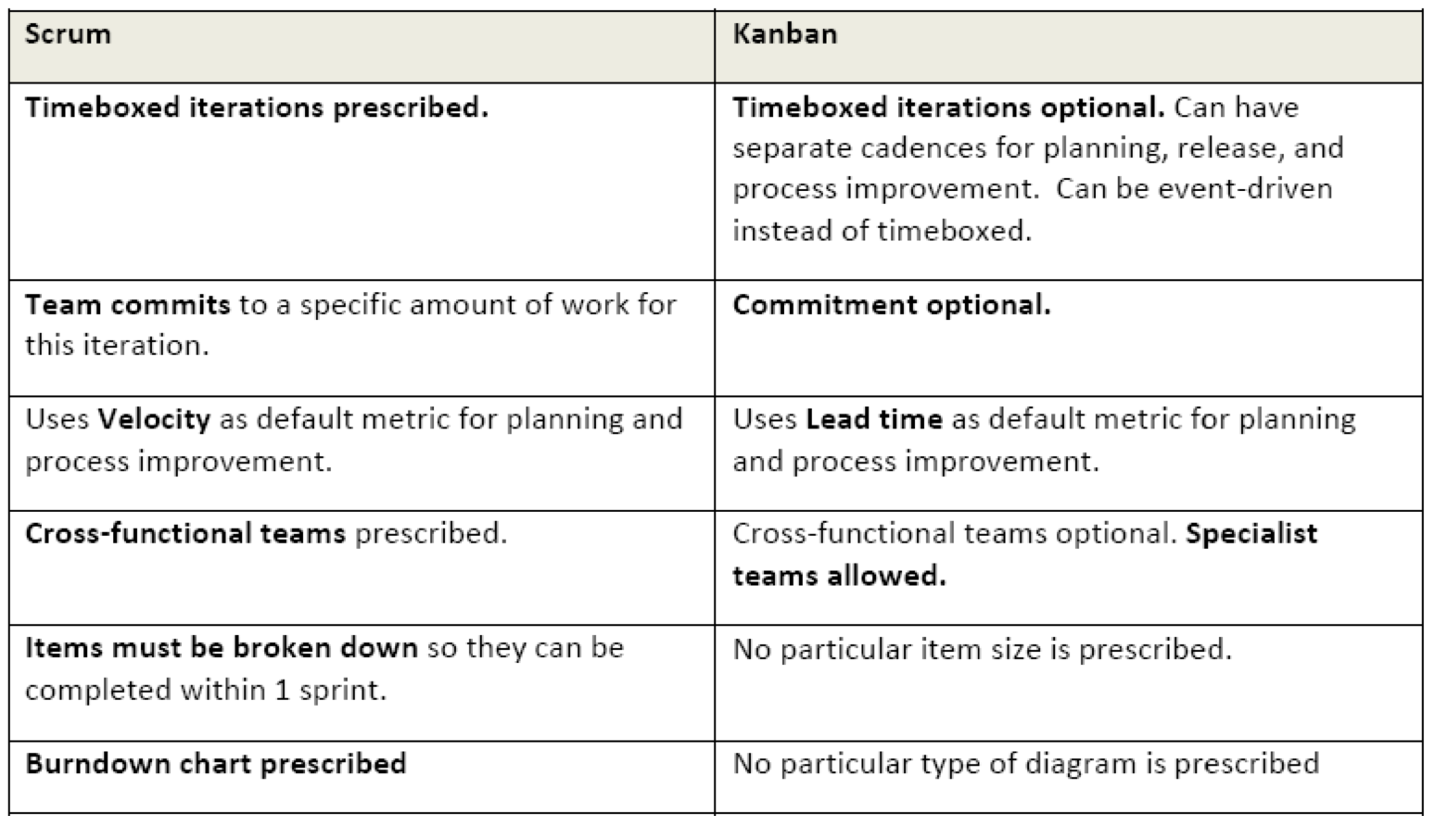
Scrum vs. Kanban
[KS2009]

Slide 46
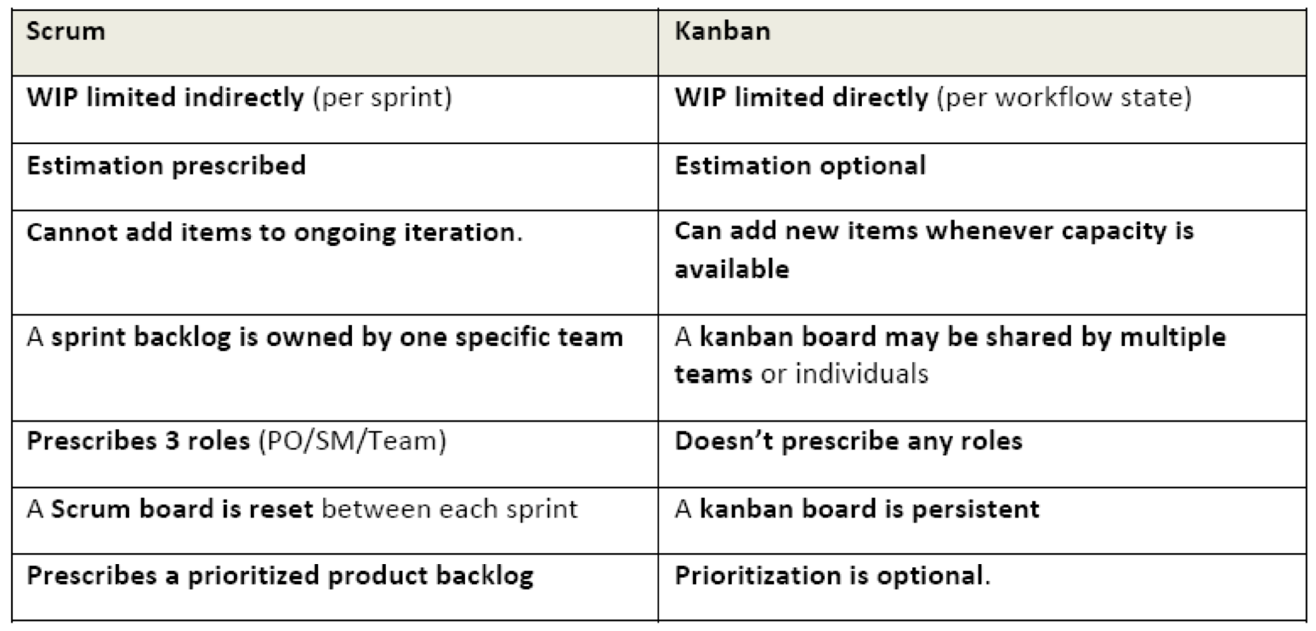
Scrum vs. Kanban
[KS2009]

Slide 47
Agile Principles
Early and continuous delivery of valuable software
Welcome changing requirements, even late
Deliver working software frequently
Business people and developers must work together
Build projects around motivated individuals
Face-to-face communication is most effective and efficient
Working software is the primary measure of progress
Sustainable development
Continuous attention to technical excellence and good design
Simplicity is essential
Self-organizing teams
Regular reflection
Notes:
Task: For each of the principles, compare XP, Scrum, and Kanban and discuss differences
NOW: Pick two – the others might be a good exercise for exam and report.

Slide 48
Agile Principles – Revised list (according to [Mey2014])
Task: For each of the principles, compare XP, Scrum, and Kanban and discuss differences NOW: Pick two – the others might be a good exercise for exam and report.
Organizational
Put the customer at the center.
Let the team self-organize.
Work at a sustainable pace.
Develop minimal software:
Produce minimal functionality.
Produce only the product requested.
Develop only code and tests.
Accept Change
Technical
Develop iteratively:
Produce frequent working iterations.
Freeze requirements during iterations.
Treat tests as a key resource:
Do not start any new development until all tests pass.
Test first.
Express requirements through scenarios.
6. Reflect regularly and improve continuously!

Slide 49
References
[KS2009] Henrik Kniberg and Mattias Skarin: Kanban and Scrum – Making the Most of Both. InfoQ (2009) Available online:http://infoq.com/minibooks/kanban-scrum-minibook

